Slide 1
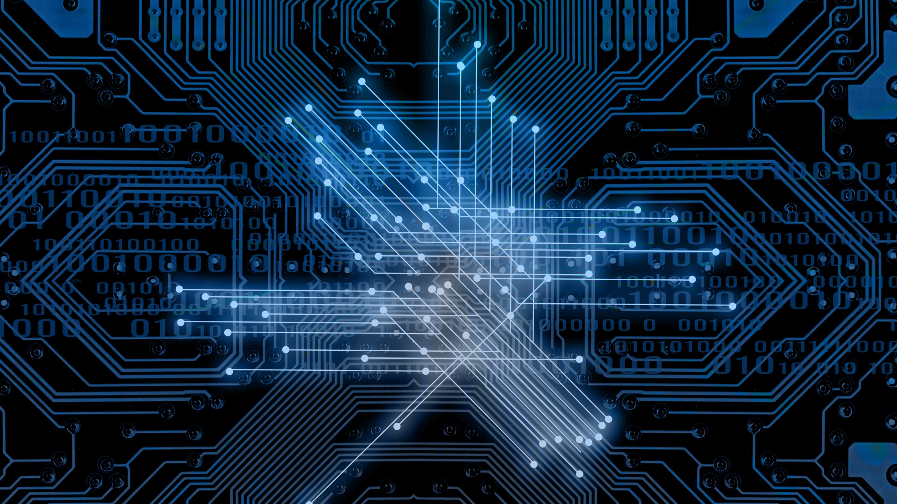
Automatic Water level Detector
Muhammad Danish
SP19-BEL-020

Slide 2
Objective
It is mainly a home automation project, which is used to maintain the water level in a tank.
It can also save electricity and avoid the wastage of water.

Slide 3
Components
Arduino UNO R3
Relay
Variable Resistor
Ultrasonic sensor
DC Motor
LCD 16x2

Slide 4
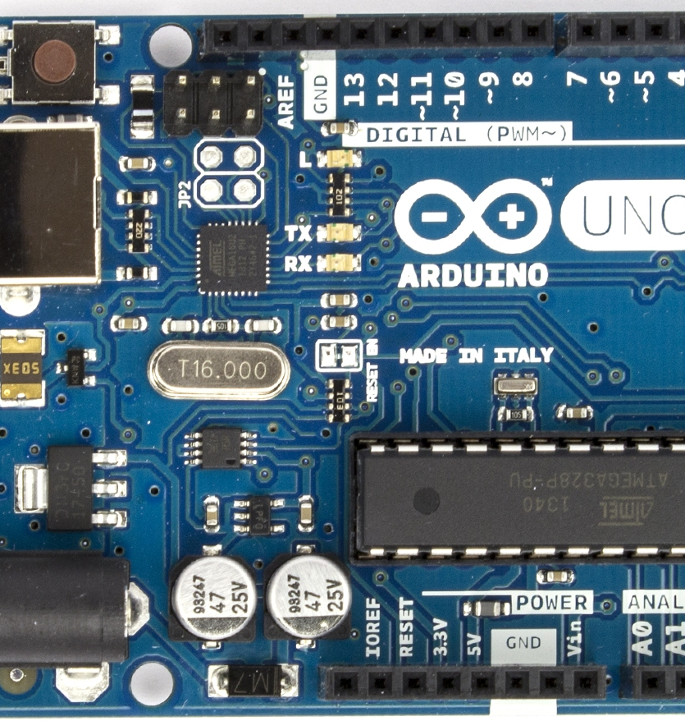
Component Explanation
Arduino uno R3 has total 32 pin •
14 pins are Digital (D0 to D13) Can be used as input or output pins•
6 pins are Analogue (A0 to A5) (Used to provide analog input in the range of 0-5V) • 3 grounded pins.•
Default 5V is Regulated power supply used to power microcontroller and other components on the board.•
Default 3.3V supply generated by on board voltage •
Vin is an Input voltage to Arduino when using an external power source
This Photo by Unknown author is licensed under CC BY-SA.

Slide 5
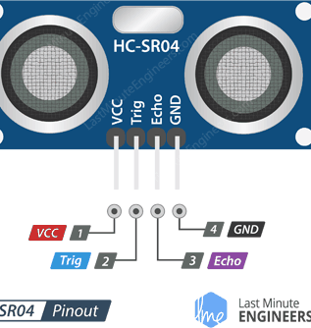
Component Explanation
VCC is the power supply for HC-SR04 Ultrasonic distance •
Ultrasonic Sensor which we connect the 5V pin on the Arduino•
Trig pin is used to trigger the ultrasonic sound pulses•
Echo pin is Produce a pulse when the reflected signal is received •
GND pin is connect to ground port of Arduino

Slide 6
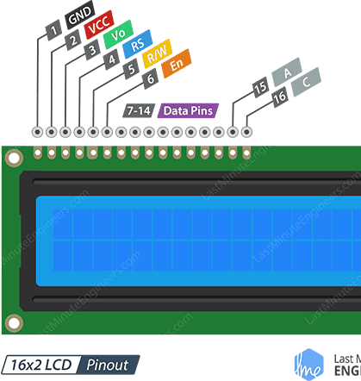
Component Explanation
GND should be connected to the ground of Arduino•
VCC is the power supply for the LCD which we connect the 5 volts pin on the Arduino •
Vo (LCD Contrast) controls the contrast and brightness of the LCD•
R/W (Read/Write) we’re just using this LCD as an OUTPUT device, we’re going to tie this pin LOW. This forces it into the WRITE mode•
E (Enable) when this pin is set to HIGH, the LCD is processing the incoming data.

Slide 7
Working
This project is based on home automation in which we use Ultrasonic sensor, in order to detect the water level in tank.
When the water level is down, it convey the signal to Arduino board which can automatically on the motor to fill the tank.
When the tank is about to fill, ultrasonic senor convey the signal to board which can automatically off the motor.

Slide 8
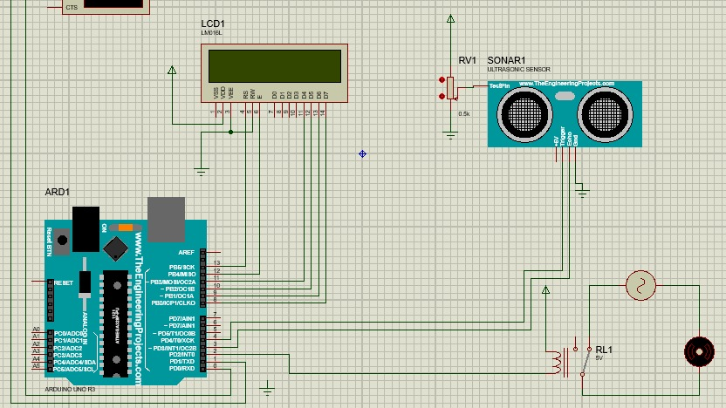
Circuit Diagram

Slide 9
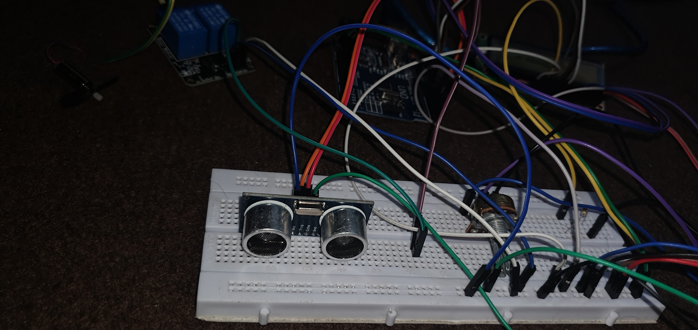

Slide 10
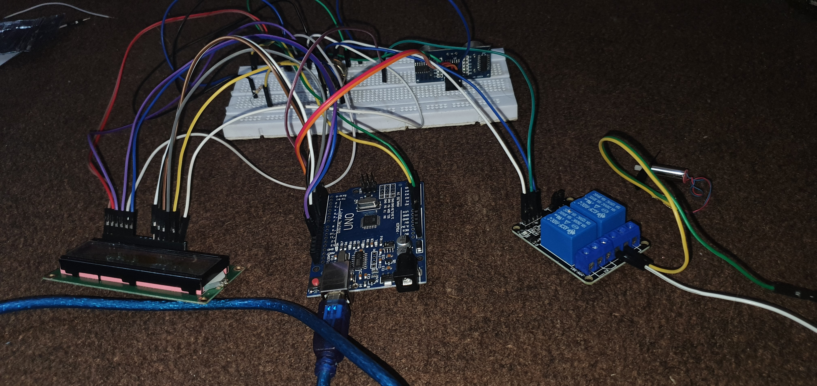

Slide 11
